Slide 1

Parallel & GPU Computing
11.20.24

Slide 2
Learning Objectives
Identifying Parallel Components
Writing parallel code
Identifying when GPU computing is useful

Slide 3
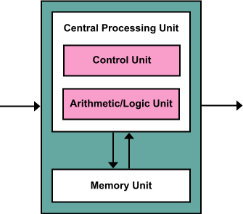
Hardware Refresher
Control Unit: sends instructions for I/O, memory fetches and ALU
ALU: Does all of the calculations
Local Memory (Cache): Small, high-speed storage
Cache on the core (L1)

Slide 4
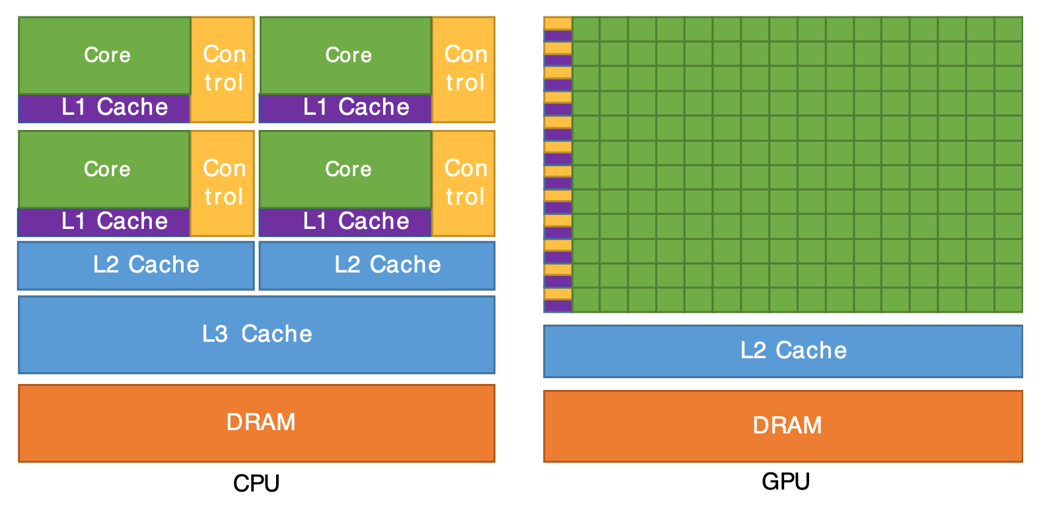
The Hardware
Both use DRAM for larger data which is shared between cores
CPUs: dozens of cores
GPU: thousands
CPU
GPU
NOTE: modern CPU cores usually have dedicated L2, although older ones might share a few L2 (as in figure)

Slide 5
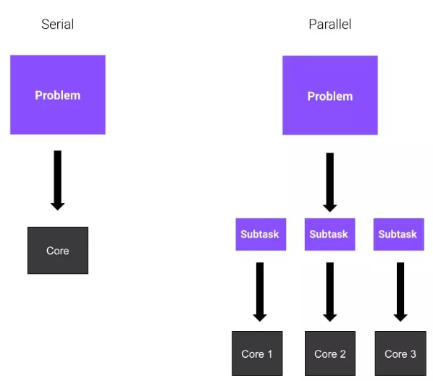
Serial vs. Parallel
Not all problems benefit from parallelization
Linear algebra is already parallelized in NumPy
BLAS and LAPACK libraries
Balance considerations in whether to split up cores

Slide 6
Serial or Parallel? (or both)
Multistep data-cleaning for a single file
remove nans→interpolate→smooth
Resampling data to build a null-distribution
Training a model for different parameter values

Slide 7
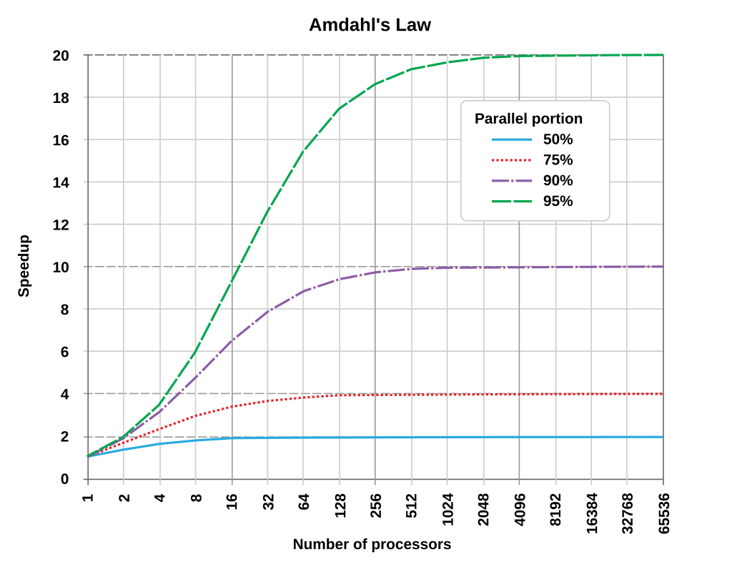
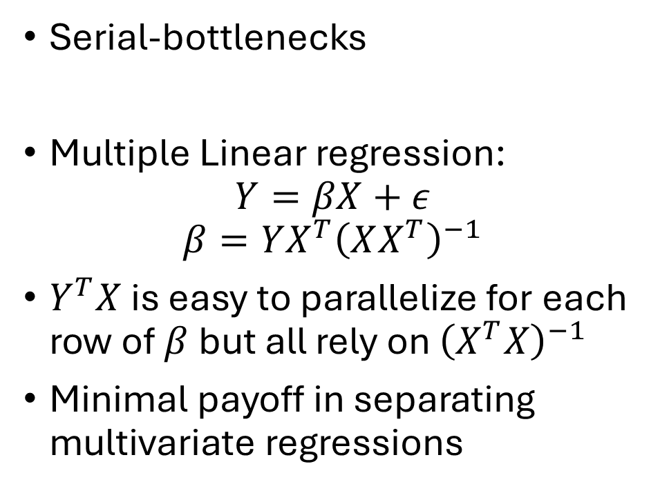
Many problems have both
Serial-bottlenecks
Multiple Linear regression:
$$Y=βX+ε$$
$$β=YX^{T}{\left(XX^{T}\right)}^{−1}$$
$Y^{T}X$ is easy to parallelize for each row of $β$but all rely on ${\left(X^{T}X\right)}^{−1}$
Minimal payoff in separating multivariate regressions

Slide 8
Types of Parallel Problems (non-exclusive)
Separate Instructions
Single Instruction, Multiple Data
Message Passing Interface

Slide 9
Some Issues in Parallel Processing
What does each core get to see?
How to keep cores from overwriting each-other
How to prioritize access to shared resources?
Coordinating interacting-parallel processes

Slide 10
The Multiprocessing Package
Part of Python standard library
Separable control of cores
4 Classes: Process, Queue, Pipe, Lock
We’ll focus on the first 2
Pipe is for Message-Passing Interfaces
Lock is for thread safety (both worth looking into further…)

Slide 11
Multiprocessing Programming
Use the process-class to control individual workers
Use the Pool submodule to set up parallel pools (loops)

Slide 12
Processor-Class Parallel
Each worker (core) is given a function and some arguments
If you want to return output, use a queue within the function
Common queues will save output in the order it is received.

Slide 13
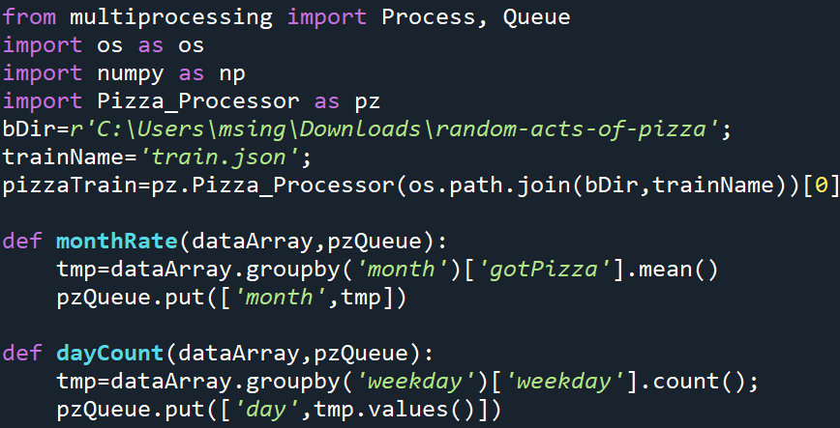
Setup for parallel pizza
One function returns the success-rate by month
Another function returns the number of requests by weekday

Slide 14
Processor-Class Parallel
At beginning of parallel section:
if __name__ == '__main__':
Initialize a Queue to save outputs
pizzaQ=Queue();
Initialize process objects for each task:
proc1=Process(target=monthRate, args=(pizzaTrain, pizzaQ))
proc2=Process(target=dayCount, args=(pizzaTrain, pizzaQ))

Slide 15
Processor-Class Parallel
Execute the processes:
proc1.start()
proc2.start()
Wait until they finish (clean-exit)
proc1.join()
proc2.join()

Slide 16
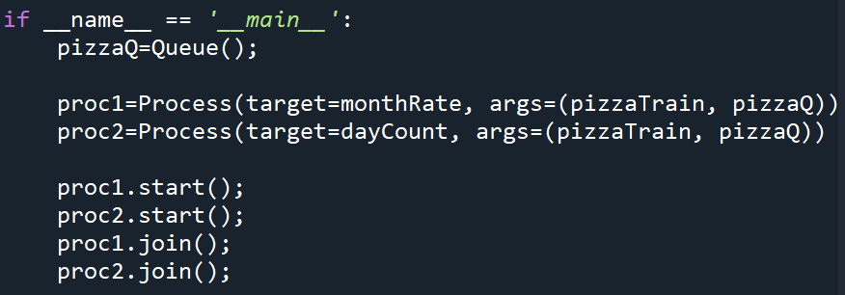
Processor-Class Parallel

Slide 17
Getting data from the Queue
The Queue object is a generator
We retrieve one object at a time (and then it’s deleted)
I created a dictionary + markers to keep track of which task corresponds to each element of the queue
(I could have also just given them separate queues)

Slide 18
Parallel Pools
In most applications we want to parallelize a loop
At beginning of parallel section:
if __name__ == '__main__’:
Create a list containing the arguments for each of the k processes
tasks=[(arg1a,arg1b…), (arg2a,arg2b…), …]
with Pool(processes=k) as pool:
results=pool.map(function_name,tasks)

Slide 19
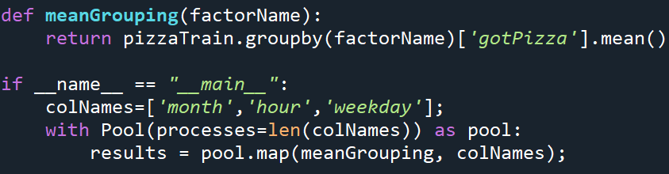
Pool Example
I’m going to get pizza success by multiple grouping-levels

Slide 20
Practice
From the midterm data
Write parallel code to load each run of subject 13833 and compute the standard deviation
NOTE: you can have more tasks than cores (it will just loop through as available)
To automatically use the max cores available
with Pool as pool:

Slide 21
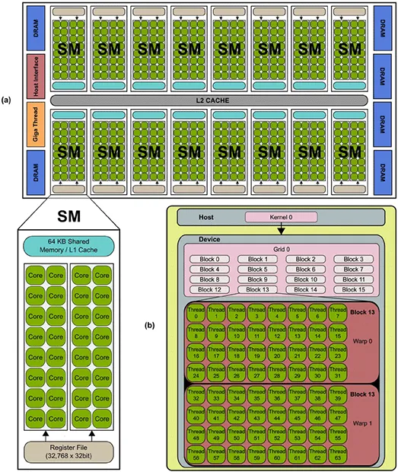
The Hardware
(modern) CPU cores have own Control Unit, ALU, and L1,L2 cache
CUDA GPUs organized into Streaming Multiprocessors (SMs)
Each SM has a memory/control unit
GPU “cores” are primarily the ALU
GPU
CPU

Slide 22
Why this matters
Streaming
Multiprocessor
CPU cores have their own control unit: separable instructions
GPU cores do not. All 32 cores within a streaming multiprocessor get the same instruction: a CUDA warp
They all do the same thing but on different parts of the data.
GPUs also have specialized cores for either 32-bit or 64-bit floating-point math

Slide 23
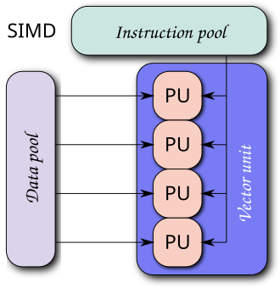
Why this matters
GPU is specialized for Single Instruction Multiple Data (SIMD)
applying the same operation at each core
(since each core doesn’t have its own control unit)
LINEAR ALGEBRA
Convolution/signal processing
Monte Carlo sampling
Large simulations

Slide 24
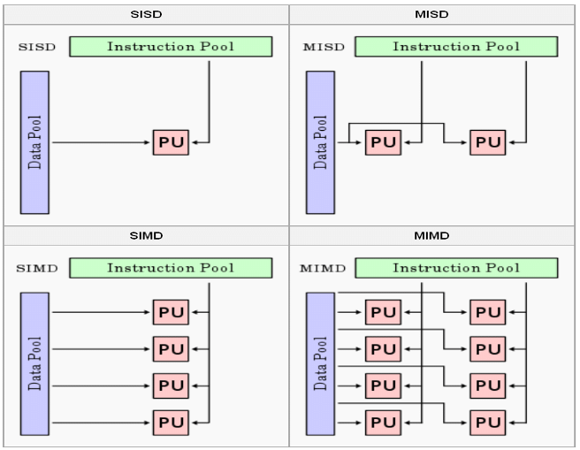
Serial
GPU Warp
CPU Parallel

Slide 25
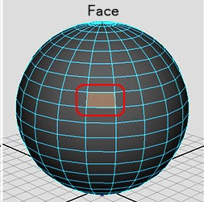
FYI—what’s this got to do with graphics?
Recall from prev. surfaces are represented by:
Vertices (N x 3 matrix)
Connection graph
GPUs are designed to evolve the vertex matrix
Rigid-body mechanics
Translate each vertex by a common velocity
Rotate each vertex about a common axis
Lighting, viewing, shading: All projections from 3d to 2d

Slide 26
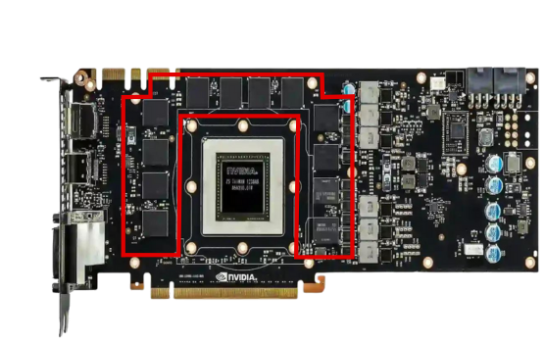
CPU-GPU Interface
Data are moved from CPU to GPU and back
This transfer is expensive: you want to minimize it
Keep as much data as possible in VRAM

Slide 27
Model Training with GPU
Train
Data
Model
Data tensors are explicitly moved onto/off of GPU
Both data and models should be on GPU
Move onto GPU
foo.to(“cuda”)
Get from GPU
foo.detach().cpu()
Return
Copy
Data
Model
Logs

Slide 28
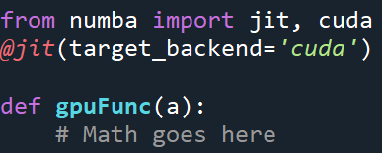
General GPU with Numba
Numba automatically turns basic Python (math stuff) into CUDA
Simplest case: Just-in-time Compiler (JIT):
JIT decorator species how
Python is compiled

Slide 29
Minimizing Transfers with Numba
By default Numba retrieves data from the GPU after each call
Can manually move data back/forth to avoid this:
dataGPU=numba.cuda.to_device(data)
dataCPU=dataGPU.copy_to_host()

Slide 30
Learning Objectives
Identifying Parallel Components
Writing parallel code
Identifying when GPU computing is useful

